Slide 1
Changing Stories; Changing Lives”
#ToughLove:
.
Mw. drs. Jean-Marie Schmidt. M.Sc.
Associate Professor Academic Success- RUAS

Slide 2
.

Slide 3
Two primary modes of thinking

Slide 4
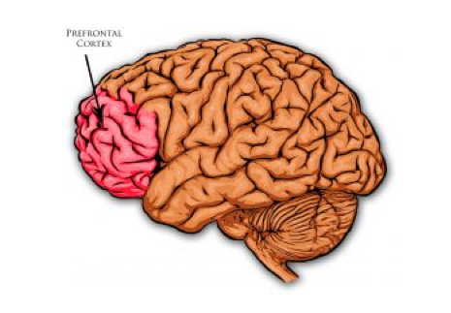
How do we come by our mindsets?
CODER
Prefrontal Cortex

Slide 5
BOTTOM UP PROCESSING
TOP DOWN (CODER) PROCESSING
Source: www.lmeglobal.net

Slide 6
Research: Correlation between mindset & achievement
Students’ beliefs about intelligence and learning impact:
Motivation
Academic behaviors (e.g., studying and seeking help)
Responses to challenges and setbacks
Academic achievement

Slide 7
“Motivation is biologically required for learning” –
Susan Kruger

Slide 8
“Emotions are the on/off switch to learning” – Priscilla L. Vail

Slide 9
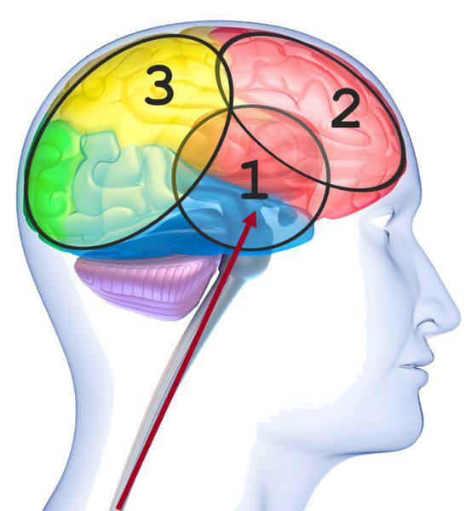
Emotional Center.
Management executive function skills.
Manages learning.
(Kruger, 2022)

Slide 10
—James Anderson
“There’s a big difference between not getting better at something because ”you don’t want to”, and not getting better “because you don’t believe you can”

Slide 11
“To help demotivated students we need to help them understand they can learn.We help them understand they can learn by showing them they can learn” – James Anderson

Slide 12
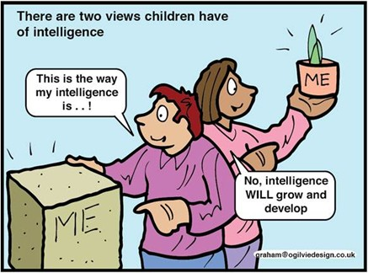
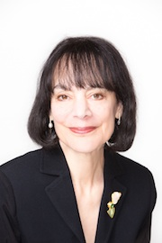
Growth Mindset vs. Fixed Mindset
Notes:
Carol Dweck, who pioneered this research, began studying students’ beliefs about intelligence because she was interested in the question of why some students are so resilient in the face of challenges while others are not.
What she found was that students generally hold one of two very different beliefs about intelligence. Some students have what she calls a “fixed mindset” - the belief that intelligence is a fixed trait that doesn’t change much. So, like eye color - these students believe you’re born with a certain amount of it and there’s not much you can do to change it. Other students have a very different belief about intelligence - a growth mindset. They see it more like a muscle that grows with effort.

Slide 13
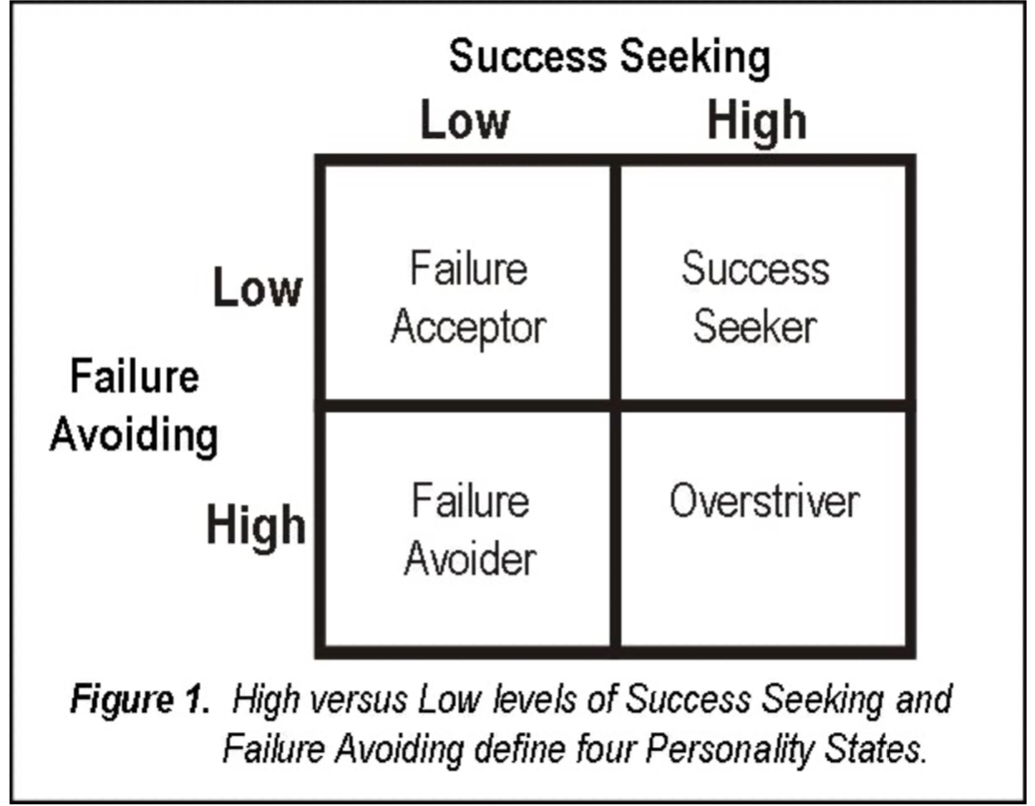
4 MOTIVATIONAL TYPOLOGIES
FIGURE 1. The four motivational typologies defined by achieving success versus avoiding
failure. Source: (Geller, 2016).
Notes:
Figure 1 depicts four distinct achievement typologies deﬁned by
Covington (1992) and derived from the seminal research of Atkinson (1957,
1964). These four classiﬁcations have been researched to explain differences
in how people approach success and/or avoid failure (Covington & Roberts,
1994). It is most desirable to be a success seeker. These are the optimists who
respond to setbacks (e.g., to corrective feedback) in a positive and adap-
tive manner. They are self-conﬁdent and willing to take risks, as opposed to
avoiding challenges to avoid failure. They wake up each day to an opportu-
nity clock rather than an alarm clock. It is a mindset or attitude toward life
you can inﬂuence in yourself and others with situational manipulations.
Failure avoiders have a low expectancy for success and a high fear
of failure. They do whatever it takes to protect themselves from appearing
incompetent. They often use self-handicapping and defensive pessimism to
shield themselves from experiencing failure (Berglas & Jones, 1978). These
individuals are motivated but are not happy campers. They are the studentswho say, “I’ve got to go to class; it’s a requirement,” rather than, “I get to go
to class; it’s an opportunity.”
Bottom line: Applying soon, certain and positive consequences is the
most efﬁcient way to improve behavior and attitude at the same time.
Of course, every reader of this article knows this and also knows the term
positive reinforcer should only be used if the positive consequence increases
the frequency of the target behavior. But even when positive consequences
do not result in an observable change in behavior, they are still useful. They
might, in fact, affect an unobserved behavior, and they likely beneﬁt an atti-
tude or person-state, possibly enhancing a success-seeking mindset. These
consequences are called rewards, as you know.
Using this life lesson on a daily basis is both critical and challenging.
Why? Because we seem to live in a click-it-or-ticket culture that relies on
negative reinforcement and punishment to manage behavior, from the class-
room and workplace to our homes, and during our travel in between.

Slide 14
4 MOTIVATIONAL TYPOLOGIES
Failure Acceptor
Failure Accepter
Success Seeker
Failure Avoider
Overstriver
(Geller, 2004)

Slide 15
4 MOTIVATIONAL TYPOLOGIES
Failure Accepter
Success Seeker
Failure Avoider
Overstriver
Failure Avoider
(Geller, 2004)

Slide 16
4 MOTIVATIONAL TYPOLOGIES
Failure Accepter
Success Seeker
Failure Avoider
Overstriver
(Geller, 2004)

Slide 17
4 MOTIVATIONAL TYPOLOGIES
Failure Accepter
Succes Seeker
Success Seeker
Failure Avoider
Overstrivers
(Geller, 2004)

Slide 18
Recursive Process
Higher Achievement
Increased Effort
Growth Mindset
Challenge or failure
Fixed
Mindset
Reduced Effort
Lower Achievement
Notes:
NOTE: THIS SLIDE IS ANIMATED. [ADVANCE] INDICATES WHEN YOU SHOULD CLICK ADVANCE TO BRING UP THE NEXT PART OF THE SLIDE.
The reason these mindsets can have such an impact on achievement has to do with the recursive process that takes place when students experience a challenge or setback.
[ADVANCE] When a student w/ a GMS experiences a setback
[ADVANCE] they increase their effort
[ADVANCE] which leads to better results
[ADVANCE], which then reinforces their belief that they can improve – it reinforces their growth mindset.
[ADVANCE] Students with a fixed mindset have the opposite recursive process taking place. [ADVANCE] They experience a failure,
[ADVANCE], they reduce their effort,
[ADVANCE], which leads to lower achievement over time,
[ADVANCE] which then reinforces their belief that they don’t ‘have what it takes.’

Slide 19
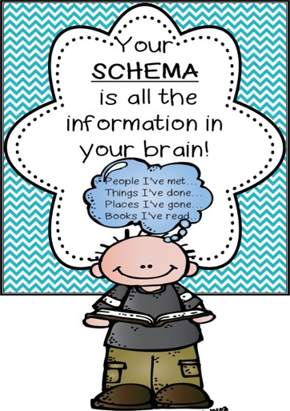
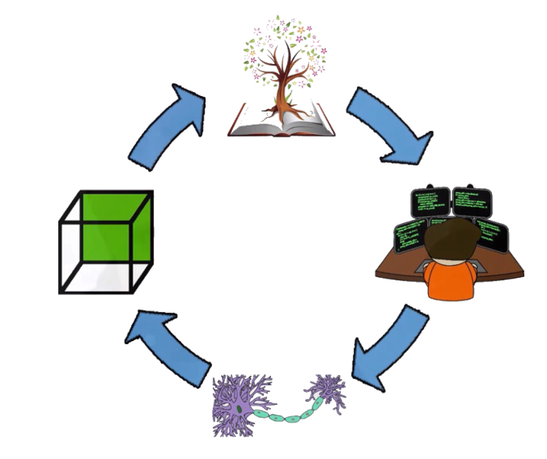
How do we come by our mindsets?
Source; www.lmeglobal.net

Slide 20
How do we CHANGE our stories?
Learning
Change the ruleset not the difficulty
Errors

Slide 21
What’s your choice?
Engage
Ignore

Slide 22
What do we know?
Mindset
Beliefs
Failure
Motivation
This under CC BY-NC

Slide 23
How do we CHANGE our stories?

Slide 25
STEP FOUR
Teach Metacognition
& effective learning strategies
STEP TWO
STEP THREE
STEP FIVE
Identify student Motivation typology
Teach students the value and significance of Stories, Errors and Effective Effort
Employ Feedback to guide and adjust student learning process
STEP ONE
Unravel student
dominant Mindset
coping mechanism

Slide 26
Guiding Questions:
How do students view their own intelligence?
How do students describe their past learning experiences?
What are students more focussed on: process or result?
Step 1 is not aimed at categorizing students but rather at gaining understanding of what is impeding their learning + what drives their experience of the world
STEP ONE
Unravel student
dominant Mindset
coping mechanism

Slide 27
Guiding Questions:
How do students define failure?
How do students define success?
How do students react to and interpret failure?
Step 2 is necessary to understand how students define success + how they interpret and react to failure
STEP TWO
Identify student Motivation typology

Slide 28
Guiding principles:
Discuss the power of our stories and their influence on our learning
Discuss mistakes in relation to interpretation and reaction to failure
Discuss the value of effective effort
Discuss the aspect of choice when dealing with errors
Step 3 aims to help students identify their stories + reflect on how their stories are serving them.
STEP THREE
Teach students the value and significance of Stories, Errors and Effective Effort

Slide 29
Metacognition Cycle (Ambrose et al.,2010)
STEP FOUR
Teach Metacognition
& effective learning strategies

Slide 30
Guiding principles:
Planning
goal setting, activating relevant prior knowledge, selecting appropriate strategies, and the allocation of resources (for example, how much time is going to be spent on the task)
Monitoring
Includes the self-testing activities that are necessary to control learning, for example retrieval practice during a learning task
Evaluation
Refers to appraising the outcomes of one’s learning, and deciding whether to use a different strategy next time (Muijs, 2020)
Step 4 aims to help students reflect on their approach to learning
STEP FOUR
Teach Metacognition
& effective learning strategies

Slide 31
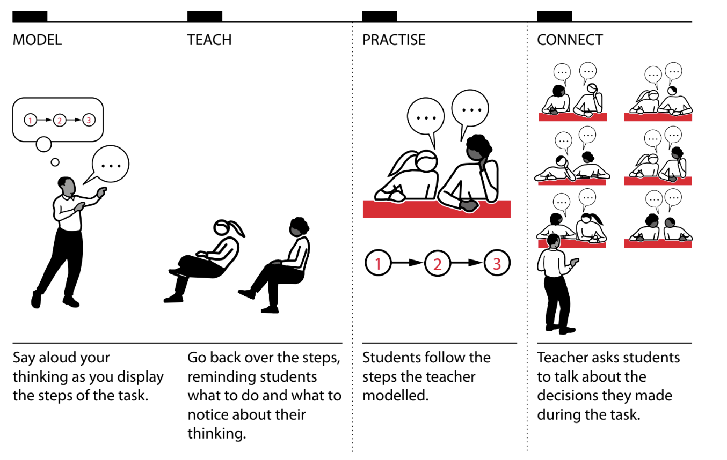
Model for teaching Metacognition (Taylor, 2019)
STEP FOUR
Teach Metacognition
& effective learning strategies

Slide 32
STEP FIVE
Employ Feedback to guide and adjust student learning process
(Killian, n.d)

Slide 33
FEEDBACK
What should you stop doing?
Where am I going?
What should you keep doing?
Where am I now?
What should you start doing?
What do I need to get there?
FEEDBACK
(Schmidt, 2020)

Slide 34
Source: www.lmeglobal.net

